Slide 1
Lecture 1
C++ Basics I
Variable Classes
Seoul National University
Graphics & Media Lab

Slide 2
Contents
compile & execute (1.1)
simple C++ program (1.2)
comment (1.3)
types, variables (2.1-2.8, 5.8, 7.5)
scope of variables (2.3.6)
const qualifier (2.4)
basic expressions (5.1, 5.2, 5.4, 5.5, 5.7, 5.9, 5.11)
basic statements (6.1-6.11)
class (1.5)

Slide 3
Compile & Execute
Write or edit source code
Fix bugs that emerge during compilation
Compile source code
Fix bugs that emerge during execution
Link object code
Run program

Slide 4
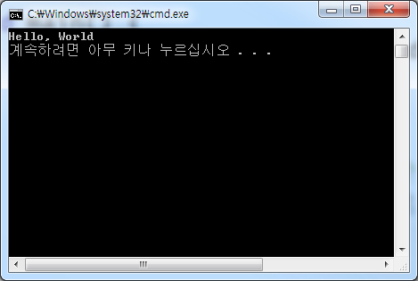
A Simple C++ Program
#include <iostream>
void main() {
std::cout << “Hello, World” << std::endl;
}

Slide 5
Putting Comments
Comments are ignored by the compiler.
Comments can help readers understand the code.
//
/* … */
#include <iostream>
void main() {
int u = 1, v = 2;
std::cout << u + v; // sum of u and v
/* sum of u and v */
}

Slide 6
Types, Variables
Primitive built-in types
void
bool, char, w_char, short, int, long, float, double
unsigned char, unsigned int, …
#include <iostream>
void main() {
int height = 11, width = 9, length = 40;
int result = height * width * length;
std::cout << "The volume of the box car is ";
std::cout << result << std::endl;
}

Slide 7
Types, Variables
Enumerations
Enumerations provide an alternative method for defining/grouping sets of integer type constants.
#include <iostream>
void main() {
enum Forms { shape = 1, sphere, cylinder, polygon };
std::cout << shape << sphere << cylinder << polygon;
}

Slide 8
Types, Variables
typedef
typedef allows us to define a synonym for a type
#include <iostream>
typedef double wages; // wages is double
typedef int exam_score; // exam_score is int
typedef wages salary; // salary is wages (double)
void main() {
wages wage0 = 200, wage1 = 300;
exam_score score0 = 90, score1 = 100;
std::cout << wages0 << score0;
std::cout << wages1 << score1;
}

Slide 9
Types, Variables
sizeof
The sizeof operator returns the size (in bytes) of a type or an object.
#include <iostream>
typedef double wages; // wages is double
typedef int exam_score; // exam_score is int
void main() {
wages w;
std::cout << sizeof(int) << sizeof(exam_score);
std::cout << sizeof(double) << sizeof(wages);
std::cout << sizeof(w);
}

Slide 10
Scope of Variables
Local and global variables
#include <iostream>
int a = 3;
void main() {
int b = 5;
{
int c = 7;
cout << a << b << c;
}
cout << a << b;
cout << c; // Compilation Error !
}
Global variable
Scope of variable c

Slide 11
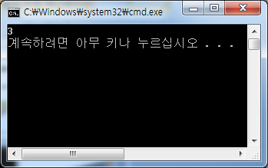
Scope of Variables
extern
We can declare a global variable without defining it by using the extern keyword.
main.cpp
tmp.cpp
#include <iostream>
extern int a;
void main() {
std::cout << a << std::endl;
}
int a = 3;
declaration
of a
definition of a

Slide 12
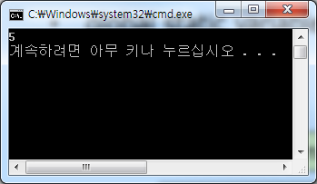
Scope of Variables
static global variable
We can define a global variable as static to make its scope local to a file.
main.cpp
tmp.cpp
#include <iostream>
static int a = 5;
static int f() {}
void main() {
std::cout << a << std::endl;
}
static int a = 3;
static int f() { }
different definitions
of variable a

Slide 13
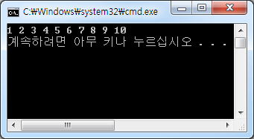
Scope of Variables
local static variable
Local static variables of a function are kept intact when the function returns.
#include <iostream>
void func() {
static int a = 0;
a++;
std::cout << a << " ";
}
void main() {
for(int i=0;i<10;++i)
func();
std::cout << std::endl;
}
Local Static Variable

Slide 14
Const Qualifier
const
A constant is a special kind of variable whose value cannot be altered in the program.
#include <iostream>
void main() {
int a = 3;
const int b = 5; // b is const variable
a = 7;
b = 7; // Compilation Error !
}

Slide 15
Basic Expressions
Arithmetic expressions
+, -, *, /, %
#include <iostream>
void main() {
std::cout << 6 + 3 << 6 - 3 << 6 * 3 << 6 / 3;
std::cout << 5 / 3 << 5 % 3 << 5.0 / 3.0;
}

Slide 16
Basic Expressions
Numerical predicates
==, !=, >, <, >=, <=
#include <iostream>
void main() {
int i = 50;
double d = 50.0;
std::cout << (i == (int)d);
std::cout << ((double) i != d);
}

Slide 17
Basic Expressions
Conditional operator
cond ? expr1 : expr2;
#include <iostream>
void main() {
int score;
std::cin >> score;
std::cout << “The score is “ << score <<
(score==1 ? “ point” : “ points”) << “.”
<< std::endl;
}

Slide 18
Basic Expressions
Memory management
new, delete
#include <iostream>
void main() {
int * v = new int[10]; // allocate ten consecutive // integer variables
delete[] v; // de-allocate the array
}

Slide 19
Basic Statements
Conditional statement
if … else, switch
#include <iostream>
void main() {
const int v = 5;
if(v < 3) std::cout << “v is less than 3”;
else if(v < 5) std::cout << “v is less than 5”;
else if(v < 7) std::cout << “v is less than 7”;
else std::cout << “v is larger than 7”;
}

Slide 20
Basic Statements
Conditional statement
if … else, switch
#include <iostream>
void main() {
const int v = 5;
switch(v) {
case 3: std::cout << “v is 3”; break;
case 5: std::cout << “v is 5”; break;
case 7: std::cout << “v is 7”; break;
default : std::cout << “v is not 3 or 5 or 7”
}
}

Slide 21
Basic Statements
Loops
for, while, do_while
Problem
Do summation from 1 to 10
#include <iostream>
void main() {
int sum = 0;
for(int i=1;i<=10;++i)
sum += i;
std::cout << sum;
}

Slide 22
Basic Statements
Loops
for, while, do_while
Problem
Do summation from 1 to 10
#include <iostream>
void main() {
int sum = 0, i = 1;
while(i <= 10) {
sum += i;
i++;
}
std::cout << sum;
}

Slide 23
Basic Statements
Loops
for, while, do_while
Problem
Do summation from 1 to 10
#include <iostream>
void main() {
int sum = 0, i = 1;
do {
sum += i;
i++;
} while(i <= 10);
std::cout << sum;
}

Slide 24
Class
A class consists of the datafields and interface.
#include <iostream>
class Box {
public:
void print() {
std::cout << height << " " << width << " " << length << std::endl;
}
double height, width, length;
};
void main() {
Box box;
box.height = 3; box.width = 5; box.length = 7;
box.print();
}

